Slide 1
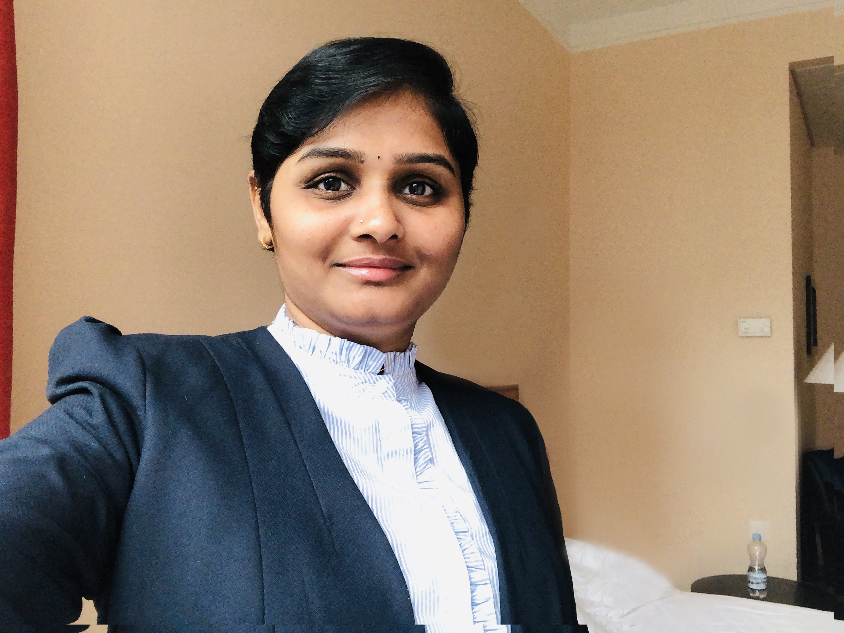
Sudharani Challa
+91 8978905566
UX/UI Lead & SDM
challa.sudharani@gmail.com
www.linkedin.com/in/sudhachalla
www. sudhachalla.gitbub.io
Over 16+ years of insightful experience in User Experience and Interface designing, managing and delivering digital transformations, applications and legacy systems. A creative designer with a passion for perfection, experience with user Interface design, UX specs, task flows, wireframes, info graphics, storyboards, mockups, prototypes, visual design and design patterns.
Skills
User Research
Design Thinking
Information Architecture
Wireframing & Prototyping
Interaction Design
Visual Design
Usability Testing
Solution Delivery
Project Management
Agile practitioner
Team Leadership
Stakeholder Collaboration
Risk Management
Oct 2016 to till date
Associate Director –Solution Delivery & UX, Novartis Health Care Pvt. Ltd.
Established UX design as the first stage of all Web and mobile application developments, instituting a user-centered design (UCD) approach.
Designed high-impact, user-centered Web sites with strong emotional appeal, sophisticated production values and intuitive navigation to maximize user engagement and powerful brand identities.
Researched, strategized and launched UX improvements for STRIDE, Motion and Ambition Programs.
Developed and implemented UX strategies and guidelines to ensure consistent and cohesive user experiences across multiple platforms.
Created wireframes, prototypes, and user flows to effectively communicate design concepts and interactions.
Facilitated workshops and design sprints to ideate and iterate on design solutions. Provided mentorship and guidance to team members, fostering a collaborative and creative work environment
Technologies
Led a team of delivery specialists in the successful delivery of multiple software projects, ensuring adherence to project timelines, budgets, and quality standards.
Collaborated with cross-functional teams including development, testing, and product management to define project scope, requirements, and deliverables.
Implemented Agile methodologies and best practices, resulting in project efficiency and customer satisfaction.
Managed stakeholder expectations and provided regular project status updates, ensuring transparency and effective communication throughout the project lifecycle.
Figma
Adobe XD
Sketch
Invision
Photoshop
HTML
CSS3
Bootstrap
JQuery
Microsoft technologies
Apr 2012 to Oct 2016
Specialist-UX - Verizon Data Services India Ltd.
Coordinating with marketing team to create user centric interface for Broadband portal, AppFinder and verizonwireless.com.
Conducted user interviews to gather insights.
Created wireframes and visual designs to enhance usability and aesthetics.
Conducted usability testing and incorporated user feedback into the final design.
Developing the cross browser and user centric frontend using html5 and bootstrap.
Developing a responsive layout using bootstrap which can be scalable to any devise irrespective of the view port size.
Designing wireframes, icons and graphics.
Creating product promotional email templates and sending across clientele
Certifications
Leadership Program from IIM Bangalore.
Jan – Dec 2019
Awards
Dec 2010 to Mar 2012
CEO field award in Novartis
Graphic & Web designer - Gyan Web Solutions
Gold Medal in Masters (MCJ)
Designed the entire product end to end.
Understood the process flow of the application and created wireframes and prototypes for all modules.
Written test cases for all the modules.
Converted the templates into html prototypes.
Designed the marketing collaterals like brochures, holders, leaflets, newsletters etc..
Education
Masters in Communication & Journalism (MCJ)
Jun 2008 to Dec 2010
Padmavati Mahila Viswa Vidyalayam, Tirupati
Content Writer & Graphic designer - Creative Technosoft Systems
2004 - 2006
Rebranded and worked on brand guidelines
Redesigned the user interface for cts-in.com
Designed in-house applications named as CTS Desk.
Designed and developed content for Marketing Collaterals (Brochures, Ads, Business Presentations, flash presentations etc.)
BA
Andhra University, Visakhapatnam
2001 – 2004

